Slide 1


Business Updates and Challenges
INVESTOR ROAD SHOW
Finance Department
Overview of the challenges facing by AFAQ Finance department in Sultanate of Oman.
Overview of Business Operation and Cash Flow Challenges facing by AFAQ AL Musana Trading LLC
UNITED FINANCE COMPANY SAOG 6/9/22
A presentation by Devraj

Slide 2

Disclaimer
This presentation contains statements relating to United Finance’s Business, financial condition, and results of operations from published information. Any statement or comment which has a meaning of future prospects and is forward-looking are only predictions and are not guarantees of future performance and does not constitute any solicitation to buy or sell any products, services, stocks, bonds, or to engage in any trading strategy and should not be relied upon or considered as advice for making any investment decisions
Due caution must be exercised that any such forward-looking statement or comments are and will be subject to both known and unknown risks, uncertainties, and factors relating to the operations and business environments of the company that may cause the actual results of the company to be materially different from any future results expressed or implied in such forward-looking statements.
By accepting delivery of this presentation, the recipient agrees to accept and be bound by the statement, restrictions, and limitations set.

Slide 3
TURNING POINT

Slide 4






AHEAD OF THE GAME
AND MUCH MORE….
Notes:
Apple 2000
Netflix 2007
DBS 2009 Piyush

Slide 5
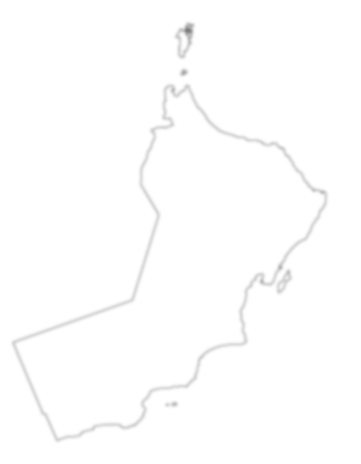
Oman’s transformation?

Slide 6
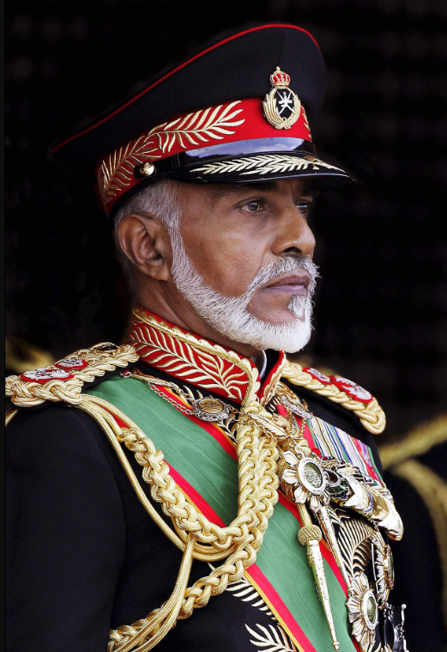
OMAN’S NARRATIVE

Slide 7

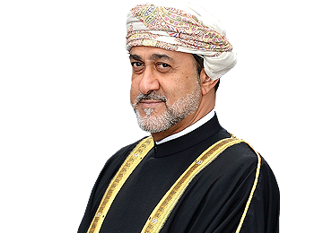
THE NEW NARRATIVE

Slide 8
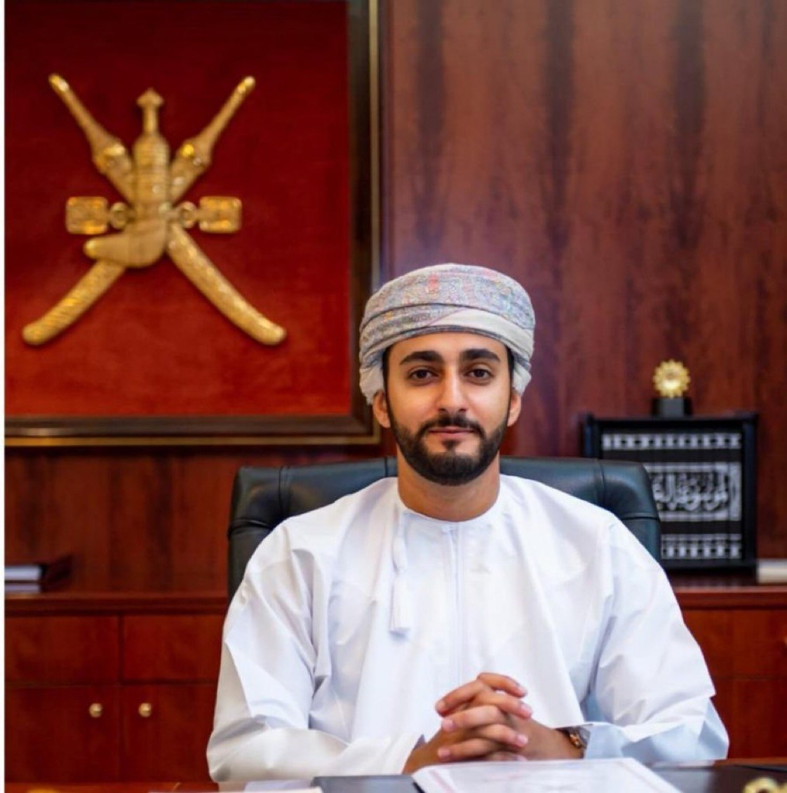
THE NEW NARRATIVE

Slide 9













THE NEW OUTLOOK

Slide 10



THE NEW OUTLOOK

Slide 11
CONTENT
Intro
Company overview
Core Focus Area
Business Overview
Financial Performance

Slide 12

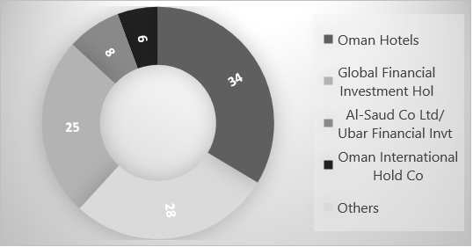
COMPANY OVERVIEW
BUSINESS DESCRIPTION
SHARE HOLDING DISTRIBUTION %
Established in 1997, United Finance Company operates within the Sultanate of Oman to retail and corporate customers.
Listed on the Muscat Stock Exchange (Ticker: UFCI) since Jul 2002.
Currently holding 9% of FLCs market share.
Head Office in Muscat, Oman and employs more than 138 people with Omanisation over 84%.
PRODUCT AND SERVICES
CATEGORY | DESCRIPTION
Retail | Financing for new & pre-owned vehicles Financing for consumer durable
Corporate & SME | Equipment finance Working capital finance Sale & lease back solution to refinance existing fixed assets Debt factoring solutions
Corporate Deposit | Provide flexible deposit schemes offering higher rate of return with flexible renewable or redeemable options

Slide 13
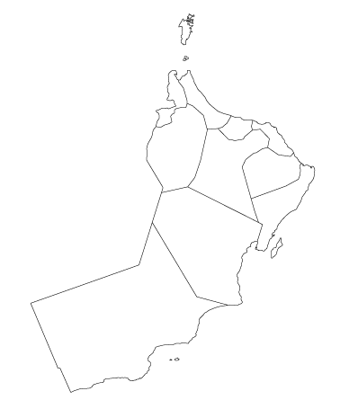


OUR NETWORK
Sohar
Barka
Formed in 1997
9% FLCs Market Share (on netbook)
8 Branches across Oman
10,000+ Active customers
130+ employees
Nizwa
Head Office
Ibri
Al Mawaleh
Ibra
Salalah

Slide 14
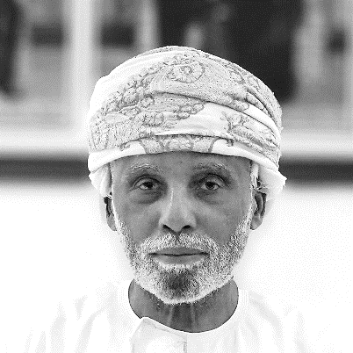
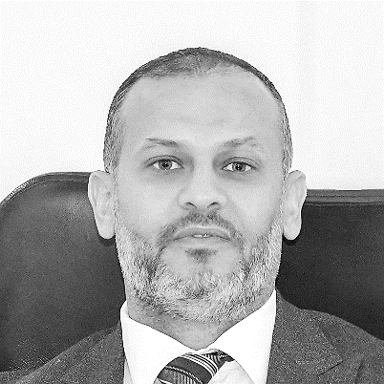
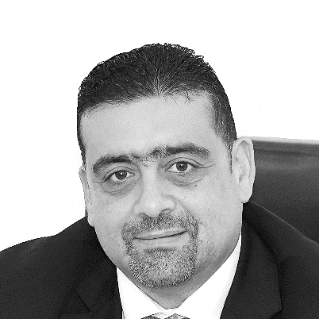
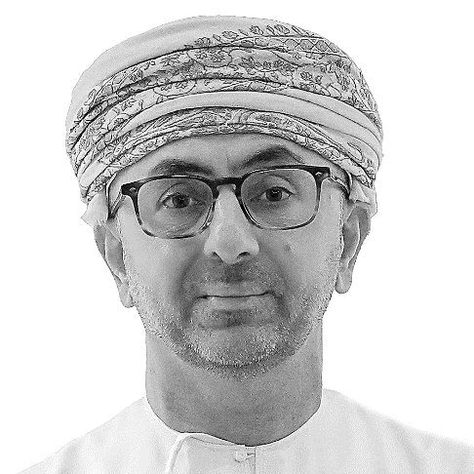
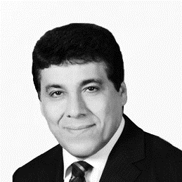
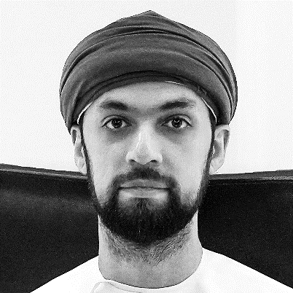
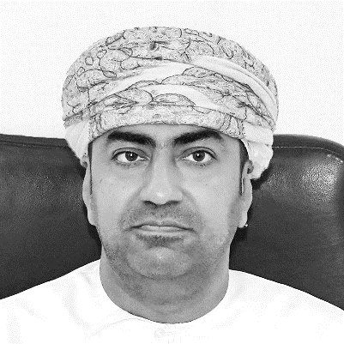
OUR BOARD
HE HASSAN IHSAN AL NASIB
WASEEM SALAH QARAEEN
HUSSAM HISHAM BOSTAMI
Deputy Chairman
Board Member
Board Member
HE holds a Masters in Military Science. He has over 37 years of experience at the Ministry of Defense. He has contributed to the establishment of many companies
Mr. Qaraeen holds a master’s certificate (MBA) from Bedfordshire He has more than 20 years of experience in the field of Investments, Internal and External Audit.
Mr. Bostami is the acting CEO of Global Financial investments Holdings. He sits on multiple boards in various industries
MOHAMMED AL KHONJI
Chairman
Mr. Al Khonji holds a bachelor’s degree in Economics where he graduated in 1994 from the University of Northern Colorado, USA. He is a major investor in several companies and real estate in Oman with chairmanship positions in some of the companies.
FARIBORZ VESSALI
SALMAN HUSSAIN AL-LAWATI
MOHAMMED AL-RAISE
Board Member
Board Member
Board Member
Mr. Vessali holds a Master's degree in Engineering Science from the University of New South Wales, Sydney. with over 25 years of experience in strategic positions.
Mr. Al Lawati has more than 11 years of professional Experience. He is Board member of Salam Air SAOC and Oman Fiber Optic Company.
Mr. Raise holds a master of Science in Finance and Banking with more than 23 years of experience in the Banking sector.

Slide 15
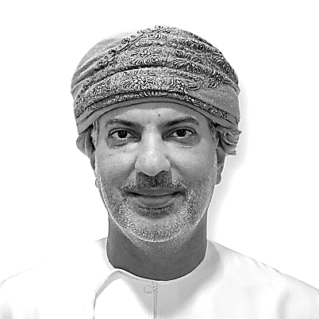
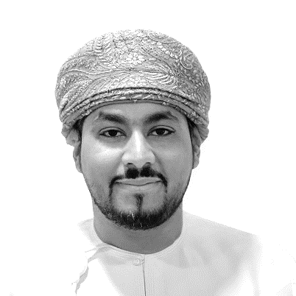
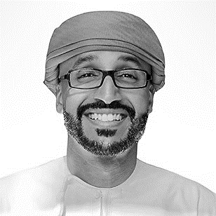
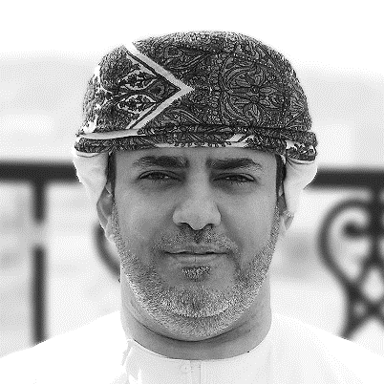
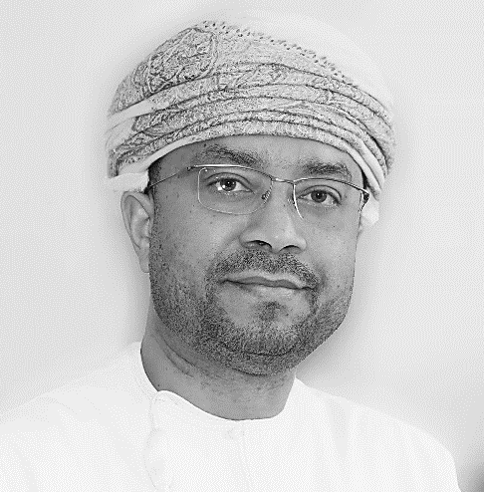
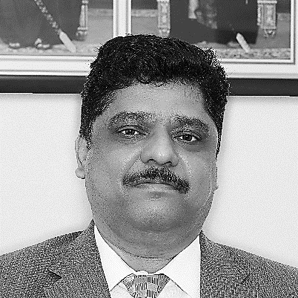
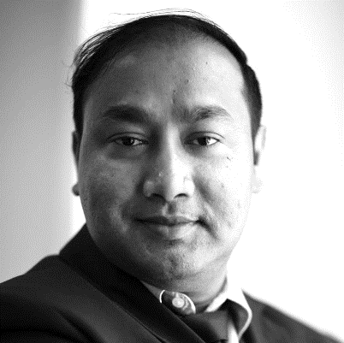
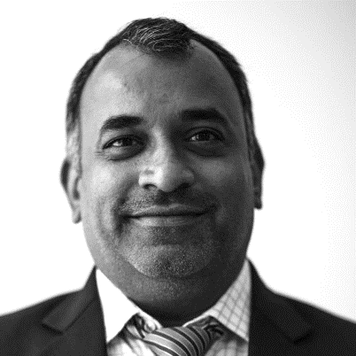
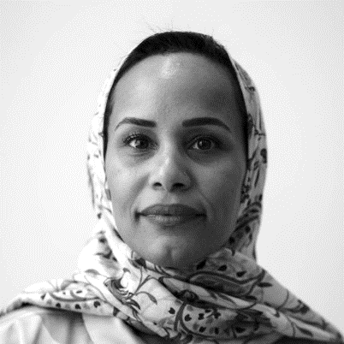
OUR KEY TEAM
ABDUL AZIZ AL MAHRIZI
FAWAZ AL RIYAMI
ABDUL AZIZ AAL ABDULSALAM
MAHMOOD AL HADI
Chief Operating Officer
Chief Business Officer
Chief Transformation Officer
AGM – HR & Admin
Al Mahrizi has over 21 years of local and international banking experience and is an alumnus of London Business School.
Al Riyami has over 15 years of experience from multiple banks in Oman and is an alumnus of London Business School
Aal AbdulSalam has over 18 years of local and international experience and is an alumnus of London Business School
Al Hadi has over 25 years of experience in various roles in the financial services industry
NASSER AL RASDHI
Chief Executive Officer
Mr. Al Rashdi has over 29 years of experience managing local and international portfolios across multiple businesses in the financial industry. He holds a Master of Science in Business Engineering from Faculte Universitaire Catholique de Mons (Belgium) and is an Alumnus of London Business School.
NANDAKUMAR R
DEVRAJ MAJI
ONKAR GOPAL BHUTADA
MAISA AL LAMKI
AGM - Risk Management
Head of Finance
Head of Audit
Head of Compliance
Nanda K has over 27 years of experience in multiple roles in the financial services industry
Maji has over 17 years of experience in various industries and holds CPA, CIMA and CMA qualifications
CA Onkar has over 17 years of experience in various roles in the financial services industry
Al Lamki has over 13 years of local and international experience in multiple fields

Slide 16
KEY INITIATIVES
Key strategic initiatives 2022
KEY INITIATIVES
Financial Performances H12022
Comparative Analysis with FLCs
FINANCIAL
COMPARATIVES

Slide 17
CORE FOCUS AREAS
3
4
Portfolio New Growth
Focus on new product development
Fee Income
Focus on Retail/de-risk existing corporate portfolio and selectively onboarding good quality corporate assets
Funding Strategy
Dealer Relationship
Paperless Office
Seamless Customer Experience/Convenience
Digital / Content Management Solution
2
5
SYSTEMS
FINANCIALS / CUSTOMER
Loan Origination Process
Revamp of Customer Touchpoints
Resolution Management
Automated Processes
Document Management solution
Write Off Collection Focus
Reorganisation of teams
Daily Reviews
Targets aligned to bottom-line growth
PROCESS
COLLECTIONS
1
6
New Executive Management Team
Performance Management
Internal Communication
Talent management
Employee Engagement
Training
Branch Relocation / Refurbishment
Setup of Marketing Hubs
Experience-based service
Superior connectivity
PEOPLE
CUSTOMER
BRANCH

Slide 18
FINANCIAL PERFORMANCES
Company overview and Key strategic initiatives 2022
KEY INITIATIVES
Financial Performances H12022
FINANCIAL
Comparative Analysis with FLC
COMPARATIVE

Slide 19
KEY FINANCIAL PERFORMANCE SNAPSHOTS
04
01
Profit & Loss A/C
Impairment & General Provision
02
03
Operating Profit RO 1.28m,
Net Profit RO 766k
Net Profit RO 689k ( with prior yr exp)
ECL RO 380K
Balance Sheet
Ratio Analysis
Net Finance Debtors RO 82.4 M.
Equity RO 46.9 M
Borrowing RO 34.3 M
Leverage 0.90
Loan loss coverage 79.5%

Slide 20

KEY FINANCIAL HIGHLIGHTS H1 2022 VS. H1 2021
Net Income RO 2.9m- increased by RO448k 18% growth
Fees RO 218k – increased by RO27k, 15% growth
Operating Income RO 1.28m–increased by RO 188k , 17% growth
ECL Provision RO 380k - Vs.RO 1,022k in H1 2021.
RO 993K management overlay maintained in books for Def.
Net Profit – RO 766k (689K) Vs. RO 41k in H1 2021.
ROE- H1 2021: 0.18%, H1 2022: 2.94%

Slide 21
HOW WE PERFORMED IN H1 2022
Finance Income
Actual H1 2022 Compared to H1 2021
+6% 3,773,489
Net Income (OMR)
+18% 2,939,554

Slide 22
HOW WE PERFORMED IN H1 2022
Other Income
Actual H1 2022 Compared to H1 2021
+15% 218,423
Operating Expenses
+18% 1,876,808

Slide 23
HOW WE PERFORMED IN H1 2022
Operating Profit
Actual H1 2022 Compared to H1 2021
+17% 1,281,168
Net Profit (OMR)
+1789.6% --766,345 (Without Prior-period expenses adj.)
-689,420 (Wit Prior-period expenses adj.)

Slide 24
BALANCE SHEET AT 30 JUN 2022
ASSETS
H1 2022
DEC 2021
H1 2021
Property and equipment | 2,312,993 | 2,330,284 | 2,360,438
Investment securities | 554,150 | 554,150 | 554,150
Deposits with CBO | 250,000 | 250,000 | 250,000
Installment Finance Debtors | 82,433,342 | 80,301,718 | 76,364,329
Deferred tax asset | 16,923 | 16,923 | 16,923
Other receivables and prepaid expenses | 193,969 | 106,976 | 313,426
Cash and cash equivalents | 695,148 | 896,294 | 2,764,443
Total Assets | 86,456,525 | 84,456,346 | 82,623,710

Slide 25
Loan Book Composition (net)

Slide 26
BALANCE SHEET AT 30 JUN 2022
LIABILITIES
H1 2022
DEC 2021
H1 2021
Share capital | 34,914,441 | 34,914,441 | 34,914,441
Share premium reserve | 528,402 | 528,402 | 528,402
Legal reserve | 5,160,755 | 5,091,813 | 4,904,497
Special Reserve | 2,368,989 | 2,368,989 | 2,368,989
Foreign Currency Reserve | - | - | 294,514
Impairment Reserve | 1,911,736 | 1,911,736 | 1,911,736
Retained Earnings | 2,083,788 | 2,510,743 | 530,381
Total Equity | 46,968,111 | 47,326,124 | 45,452,960
Bank Borrowings | 31,972,223 | 27,947,227 | 29,580,568
Corporate Deposits | 2,350,000 | 4,000,000 | 3,000,000
Creditors and other payables | 5,032,146 | 4,820,934 | 4,603,790
Taxation | 134,046 | 362,061 | (13,608)
Total Liabilities | 39,488,414 | 37,130,222 | 37,170,7850
Total Equity and Liabilities | 86,456,525 | 84,456,346 | 82,623,710

Slide 27

KEY RATIOS
Bank Borrowings to Networth
Leverage
Cost to Income
Gross NPLs
ROE- Before Tax
Staff Exp to Operating Exp
Omanization Ratio
05
01
02
03
04
06
07
08
ECL Coverage
Jun’22
0.9
Jun’22
72.59%
Jun’22
55.8%
Jun’22
26.1%
Jun’22
79.5%
Jun’22
3.7%
Jun’22
61.2%
Jun’22
84.0%

Slide 28
COMPARATIVE ANALYSIS
Company overview and Key strategic initiatives 2022
KEY INITIATIVES
Financial Performances H12022
FINANCIAL
Comparative Analysis with FLC
COMPARATIVE

Slide 29
COMPETITOR ANALYSIS – NET FINANCE DEBTORS
420M/402M
181M/170M
109M/105M
101.5M/120M
82.4M/80M
Our
Company
Al Omaniya Finance
Taageer Finance
Muscat Finance
National Finance
Net portfolio comparison H1 2022 Vs. Dec 2021

Slide 30
COMPETITOR ANALYSIS – NET PROFIT
689k/41k (1599%)
723k/782k(-8%)
5m/3.6m (38%)
1.3m/1.1m(15%)
1.34m/1m(31%)
Our Company
Muscat
Finance
National Finance
Al Omaniya Finance
Taageer Finance
Net profit comparison H1 2022 Vs. H1 2021
UFC net profit RO 776K- without prior period exp.

Slide 31

THANK YOU
Q&A

